Slide 1

Front Slide Option 1
BUS7C4
Supervision Session
Lecture
Literature
Notes:
Welcome to your online lecture for March 2025. In this lecture we will be focusing on your literature chapter of the dissertation. You should be watching this lecture at the very beginning of March so as to be able to start the work and present to your supervisor in your March supervision session.

Slide 2

Research Study Options:
Empirical based research study
Project based research study
Two research study options
☺
Notes:
By now you should have fully agreed the research study option you are going to pursue with your supervisor, be reaching the point or have already obtained ethical approval for your study and be nearing the completion of your draft methodology chapter.
Just to remind you of the clear distinction between a project-based research study - where you collect sources (i.e., journal articles) and undertake secondary data analysis on the sustainability agenda for a specific industry in accordance with the tasks set out in the project brief and an empirical-based research study - where you are designing your own study and collect existing secondary data (for example, the corporate social responsibility reports for 50 fashion retailers) or primary data from your own selected participants.
For students undertaking an Empirical Study, as a rule of thumb, your choice of topic will inform what you will do. If you are focusing on one organisation you should be collecting primary data; if you are planning to use empirical secondary data, it is more likely that data will be available at an industry level. The converse is also true: it will be a big challenge to collect enough primary empirical data to adequately represent the interests of a whole sector
Students undertaking Project have a separate section on Moodle and have already submitted their first draft of the literature review which they are using to inform the background and context for their own projects. These reviews will be refined as more knowledge of academic literature is gained through their subsequent project tasks.
Remember each option has its own brief and its own dissertation template. Make sure to use the correct template for your draft submission. Remember there are no extensions for draft submissions, you complete the submission based on your progress as of the submission deadlines.

Slide 3
Scheduled touch-points: BUS7C4
Schedule
Session 1
Options
Session 2
Methodology
Session 3
Session 4
Session 5
Literature review /collecting sources
Results/Findings
Introduction
Research instrument
Discussion
Conclusion
Ethics approval
Submission Requirements
Submission
Abstract
Notes:
The focus of this session is going to be on your literature review if you are pursuing an empirical study; or collecting your sources for your project. Whilst you may have some questions on your methodology for example, we need to keep looking forward to ensure that you continue to make progress. Questions on methodology should be directed to your supervisor. All students will work with literature during their dissertation and this will be the next chapter you draft. However there is a considerable difference between the work of a student selecting an empirical route and a student undertaking a project dissertation. Throughout this lecture make sure you listen carefully to the sections related to your chosen route and avoid confusion with the work needed by your peers who opted for the alternate route,

Slide 4
Touch-point session three:
Literature review/collecting sources
Overview this month
  Moodle content
  Up coming submission
Literature/collecting sources
  Learning outcomes/marking criteria
  Chapter content guidelines
  Aims
Notes:
First we are going to take a look at an overview of the module for this month. You will find section 3 has been added to the module on Moodle. This combined with your phase 1 work on the literature chapter and the dissertation handbook should be used to inform your work on the literature chapter for your dissertation. We will be discussing your required engagement with the content on Moodle. Next we will look at your literature search and write-up and focus on what you need to do. We will also be considering your progress so far with your literature search and starting your chapter draft and looking at any questions or concerns you may have.

Slide 5
BUS7C4
Research Project
This month
Notes:
So, let’s run through an overview of this month…

Slide 6
This month
Activities
Moodle:
  Section 3: Literature
    Part 1: The Multiple Purposes of a Literature Review
    Part 2: Literature Search - Sources of Information and Search Sentences
    Part 3: Reference Management - Keeping Records and Organising Information (RefWorks)
    Part 4: In-text Referencing System and Reference List (The Wrexham Harvard Style)
    Part 5: Reading and Note-taking Strategies
    Part 6: Structuring your Literature Review or Literature Search Summary or Background and Context Chapter
    Part 7: Critical Writing
Notes:
You have some content on Moodle to engage with during this month.
Section 3: Literature takes you through all of the information you need to prepare your literature review chapter or background and context chapter . It is divided into seven parts and takes you step by step through the process. It looks at everything from searching the literature in an efficient systematic way, through managing your references and on to structuring and writing your chapter specific to your research study option. For this section there is a lot of detail, so the required reading is highlighted - please read this as a minimum. However, if you are completing a literature-based research study this section is key for you in understanding what process to follow, so you should engage with it in full.
It is important you allocate some time to go through the required reading content. The section content should answer most of the questions you have about engaging with the literature. Just so that you are aware - both your supervisor and the dissertation stage lead can see whether you have accessed the content on Moodle; so remember to tick the mark as done button to show that you have completed a section.
You may also find it useful to go back to the taught phase content from last semester.

Slide 7
This month
Activities (cont.…)
Module textbooks
Preparation for your submission
Time to dedicate to guided independent study
You should be spending approximately 35-40 hours each week after Christmas as you move into Phase 3 of your dissertation.
Notes:
You will be engaging with both module textbooks this month – please see the recommended chapter details on Moodle.
If you haven’t already finalised your ethics approval or started your data or source collection, you will need to speak to your supervisor in the next fortnight as a matter of urgency.
Remember that to be able to achieve a good outcome in this module you will need to be spending time engaging with the content, completing the tasks set and reading widely.

Slide 8


BUS7C4: Learning Resources
Essential reading
Gray, D. (2019), Doing Research in the Business World. 2nd ed. London: Sage.
650.072 GRA
(1st & 2nd ed. available in the library)
Notes:
So just to remind you - here are the details of the two dissertation module textbooks. The Moodle content will direct you to the correct chapters...

Slide 9

BUS7C4: Learning Resources
Ridley, D. (2012), The Literature Review: A Step-By-Step Guide For Students. 2nd Ed. London: Sage.
001.4 RID
Notes:
and this month the main focus is on the textbook The Literature Review by Diana Ridley which will help guide you with engaging with the literature.

Slide 10
Formative Submission: Draft dissertation submission opportunity 1
No mark - formative submission
Review feedback received and work on this
There is no resubmission of this draft but do ask if you are unclear as to what you need to do to improve the chapter, after you have read the feedback.
Notes:
As already noted, you have the opportunity to submit a draft of your dissertation so far and you will receive feedback from your supervisor on your draft to help you make improvements to your work. There is no further opportunity to resubmit this draft, but your supervisor may ask you to send revisions or further chapters if required.
Please make use of the correct dissertation template for all dissertation submissions.
Note you will receive feedback on this draft submission and then are expected to make revisions (where needed). The feedback on the draft submission will be via your group supervision session in April 2025.

Slide 11
Literature
Notes:
So let’s move on to the Literature chapter itself.
It is really important that you understand the distinction between this chapter for an empirical study and the chapter for project based dissertation.
To start with I am going to discussion the Literature Review Chapter needed for an empirical study. This chapter follows on from your Introduction chapter and is placed as chapter 2 of your dissertation , ahead of your Methodology chapter. It should be setting out what is known about your research question before you commence your research and should be identifying gaps in knowledge. It is these gaps in knowledge that justify your study being undertaken and help you determine your specific research question. The methodology chapter follows as this is how you will answer the research question.
The literature review chapter does require you to explain how you found the relevant literature that you have included in the review and to ensure that the literature you are relying on in your discussion is of high quality. You also need to be clear that the argument you are making is a critical appraisal of your selected literature and not merely descriptive of the content of the articles.
Moving to the students who have selected a project based study, you will not have a literature review chapter at all. But you will have a Background and Context chapter to set out the business problem for your industry and your project objectives. You will use literature to evidence the sustainability issues for your industry and help you define your project objectives. This will then feed into the short methodology chapter which sets out how you will undertaken the mixed methods study, completing the tasks in the brief based on the gap in knowledge for the industry so as to develop your strategi sustainability plan.

Slide 12
Learning Outcome
At the end of BUS7C4, you will be able to…
2 | Search literature relating to the proposed research/project topic in a systematic manner and synthesise and critically evaluate the literature to produce a narrative collating the review findings in support of a specific research/project question/problem.
Notes:
This is the module learning outcome associated with the literature and it outlines what you are seeking to demonstrate. Please keep this in mind.

Slide 13
Final Dissertation Marking Criteria: Empirical-Based Research Studies
Section | 40 – 59% |  | 70% and over
Literature Review | Adequate literature search conducted using a range of academic sources including current journals but limited critical review. |  | Comprehensive literature search conducted using an extensive range of academically recognised sources with critical evaluation and synthesis.
20 Marks |  | 8-12 |  | 14-20
Notes:
and so based upon the learning outcome, here is the dissertation marking criteria for your literature review for those of you pursuing an empirical study . Note that this chapter is worth 20 marks or 20% of your final dissertation mark.
Make note that your literature review should be comprehensive and should focus on using a range of academic sources. You need to critically evaluate the literature rather than just describing it.
See the brief on Moodle for the word count guidelines.

Slide 14
Literature Review: Content Guidelines
(Empirical-Based Research Studies)
Draft chapter – first half:
Introduction
  setting out your (scope) review question…
    ‘This review will examine the literature that considers [your topic/research question].’
  search strategy
Start with a broad background
Include definitions
Discuss the historic seminal papers
Notes:
For empirical-based research studies your literature review is a large chapter within your dissertation.
It needs a chapter introduction. Your introduction sets out your scope through your review question i.e. ‘This review will examine the literature that considers [your topic/research question].’ Your search strategy can be included here.
After the introduction, you should start with the broad background looking at the wider topic area and theory area. Make sure to include some definitions of key or assumed terms. You should source these from textbooks or journal articles (rather than internet sources).
Have a small historic section noting the seminal (really important/key) papers – be they studies or articles outlining theory. You need to be very selective here as you can’t include everything! Remember a literature review is not an essay.

Slide 15
Literature Review: Content Guidelines
(Empirical-Based Research Studies)
Draft chapter – second half:
Move to more focused, more contemporary research
Note any gaps in the literature and specific calls for more research on your topic
Conclusion
  summary
  state what the research question you will take forward is
Notes:
As you progress through your chapter into the second half, you will move on to more focused literature in your specific topic area and more contemporary research (last 2-3 years).
If you have identified any gaps in the literature, you should state this towards the end and include any specific calls for your research here as well. You are trying to justify and give the reason why your study should take place.
To conclude you should briefly summarise what you found and then state what the research question you will take forward is. Note that your research question may have evolved since you started your literature review to become more specific and this is not unusual.

Slide 16
Final Dissertation Marking Criteria:
Project Based Research Studies
Learning Outcome 2 | Under 30% | 30 – 39% | 40 – 59% | 60 – 69% | 70% and over
Literature Review (or Background and Context) Total 10 marks | Literature search seriously inadequate, possibly using poor quality websites as sources. | Literature search has some deficiencies and limited range of sources, may lack clear citations. | Adequate literature search conducted using a range of academic sources including current journals but limited critical review. | Good literature search conducted using a broad range of academically recognised sources supported with some critical review. | Comprehensive literature search conducted using an extensive range of academically recognised sources with critical evaluation and synthesis.

Slide 17
Draft chapter: Aims
Focused and specific
Range of academic literature
Wrexham Harvard referencing
Third person
Notes:
You are aiming to make your literature review chapter or literature search focused enough to lead to your specific research question/research problem or review question. If your results are too many or your chapter is getting too long, you need to focus more - it may be that your topic is too broad.
In your narrative you should be seeking to use a range of academic literature. Keep websites to a minimum - use a textbook or journal article instead where possible. For literature-based studies you should only be searching for journal articles or conference papers.
You need to use the Wrexham Harvard style of referencing. You will need to edit your reference list to meet the Wrexham style. In addition, note that you must make sure that your citation is relevant to the sentence and point you are making. The whole journal article needs to be relevant not just one sentence from it. It is better to leave the statement without a source for your draft than to include a citation flag that points to something irrelevant.
Stay in the third person, so no use of ‘I’ or ‘we’ or 'the researcher'
Remember for your literature review chapter you need to synthesise and be critical, don’t just describe the literature. Is there an argument in the discourse? Are there similarities in study findings? Are there differences in study results and findings? You need to make connections and highlight any consensus or disagreement.

Slide 18
Question to the group
Do you have any questions about your literature searching strategy?
Are you happy with your progress on your literature search so far?
Do you have any concerns or are you unclear about what you need to do to be able to submit your draft on time?
Notes:
So now that you have had a chance to reflect on the work you need to do in relation to your literature search. Look at the questions on this slide and consider points you need to discuss with your supervisor in your next supervision session .
Do you have any questions about your literature search?
Are you happy about your progress with your literature search?
Do you have any concerns about your literature search or are you unclear about what you need to do?
[5 mins or as long as needed]

Slide 19
Empirical Research Students - Activity 1 to be undertaken ahead of your next supervision session: Literature
  What progress you have made so far with your literature searching? Provide your supervisor with a slide including your Search strategy.
  How many articles is your search strategy identifying?
  How will you decide which articles to include in your review ( empirical) or to take forward for analysis ( literature based study)
  Complete the 3 slides for your supervision session and submit via the assessment point on Module – note slide 1 is common to both dissertation routes but slides 2 and 3 are different for empirical and literature based studies.
Notes:
So next we are going to spend some discussing the literature searching and the work you will present to your supervision at the next supervision session. Empirical based students all need to provide a slide relating to your search strategy. Then two slides – one based on the key theories and existing knowledge found in the literature selected for the review and one demonstrating the gap in knowledge and how this informs the development of your research question.
All empirical students should submit 3 slides via the assessment point on Moodle , 2 days prior to their supervision session in March. This will be work in progress and you are not expected to have completed this chapter at this time. You should however have completed it before your supervision session in April.
Project based students have until 10th March to revise and resubmit their literature review within the background and context chapter and will receive feedback on this prior to supervision session in March.

Slide 20
Supervision Slide 1 – Literature Search Strategy
All empirical students to complete
Summary of Key Words, search sentences used and Boolean strings
Summary of bibliographic data bases used for searching
Progress to date – how many of your searches have you completed.
Indication of number of articles located through these initial searches
Notes:
This is the slide that all empirical students need to completed and submit ahead of supervision session in March. Replace the blue font with your own search information.

Slide 21
Supervision Slide 2 – Literature Search Strategy
Empirical Research Students only
From your initial searches, what are the key academic theories relevant to your topic
What definitions are you using for areas within your research?
Notes:
This slide is for empirical students and is asking you to identify key theories and definitions you have found from your searches. Don’t forget to use Wrexham Harvard references for these.

Slide 22
Supervision Slide 3 – Literature Search Strategy
Empirical Research Students only
Have you identified a gap in knowledge from your literature searched?
What is this gap?
How does that gap relate to your research question?
Will you now refine your research question based on what you have found out from your searches?
Notes:
Again this slide is only for empirical based research students. It is asking you about any gap in knowledge you have uncovered from your literature review. You need to consider how the gap identified relates to your research question and whether you now need to refine your research question in the light of the knowledge you have uncovered. If you find your research question has already been answered in the literature you have found then you need to consider whether or not your study is still justified.

Slide 23
Next on-line lecture session
This will take place at the beginning of April 2025 and will cover:
Your analysis
Your results/findings and discussion
Your conclusion chapter
Notes:
Your next online lecture will be in April – by then you should all have ethical approval in place, have submitted your draft methodology chapter and been working on your literature chapter. In January your on line lecture will be about your data/source analysis and your results/findings and discussion chapter.
In the meantime , remember to fully engage with the Section 3 material on literature.
Remember to keep engaging with your supervisor!

Slide 24
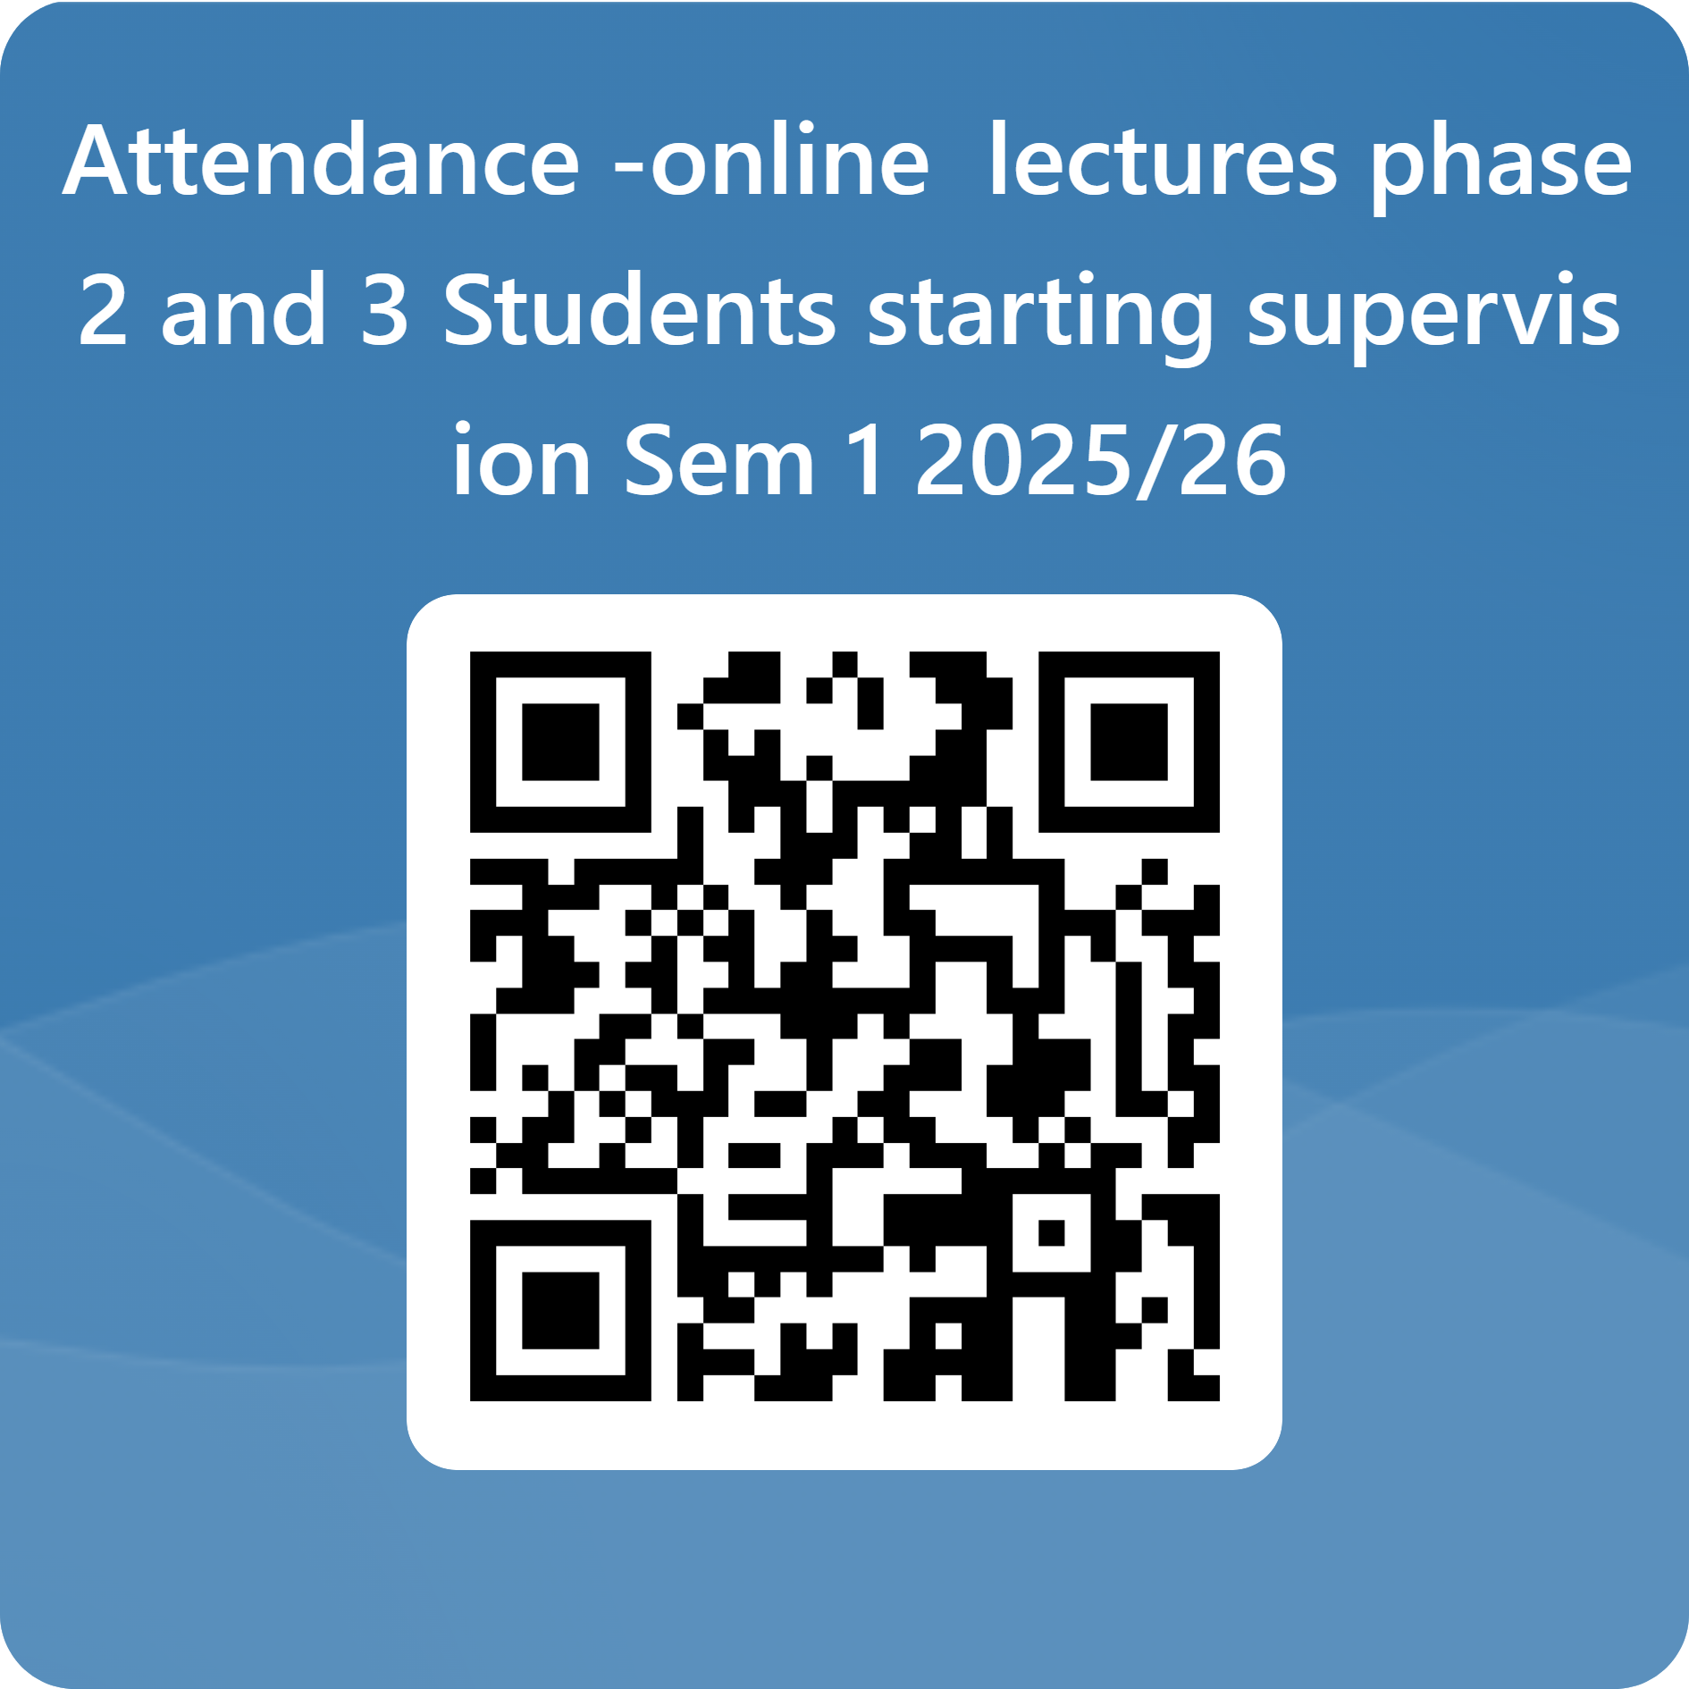
Attendance
To record your attendance please scan the QR code or enter the https: link into your browser and then record your student details
https://forms.office.com/e/RWg0pBRcNA
Notes:
Finally please record your attendance once you have completed this lecture.

